Slide 1
Mandelbrot fractal plotter and Julia set plotter.
Theoretical Introduction to topic

Slide 2
Fellowship of the madelbrot

Slide 3
That is how we worked together

Slide 4
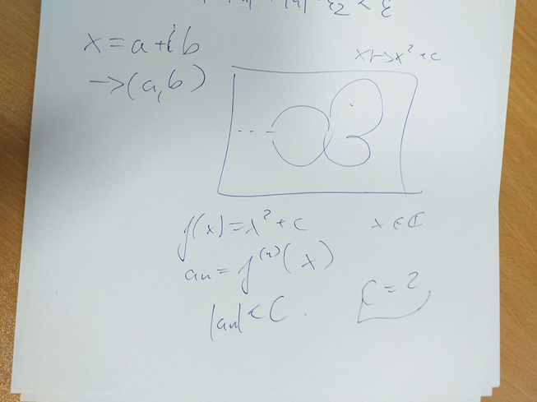
And this is the first meeting with dr. Naskręcki concerning our presentation

Slide 5
Let’s take zoom on it

Slide 7
This is our second consultation
More serious one

Slide 8
What is Mandelbrot set?
Let’s get serious, ladies

Slide 9
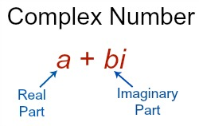
Mandelbrot set is the set of complex numbers
To remind you what complex number is
So to characterize a single complex number, we need two axes, SO OUR CODE , WHICH DRAWS MANDELROT GRAPH WILL BE 2-DIMENSIONAL, AS YOU SEE LATER
I IS A CONSTANT WHERE I^2 = -1, A & b ARE REAL NUBERS

Slide 10
IT IS ALL ABOUT ITERATION AND squaring
The Mandelbrot set is the set of complex numbers c for which the function
does not diverge when iterated from

Slide 11
Technical implementation
Rust? Shaders?

